Slide 1


Titolo presentazione sottotitolo
Development of a capacitive insole for the assessment of load distribution
Marco Banfi mat. 102328
Carlo Carraro mat. 996566
Pietro Chierico mat. 994974
Flavia Di Scala mat. 993366
Silvia Manfroni mat. 994454
Prof:
Andrea Aliverti
Tutor:
Alessandra Angelucci
Milano, XX mese 20XX

Slide 2




Introduction : Application Fields
Injury prevention
Biometric analysis
Rehabilitation support systems
Sports performance
Footwear design
Foot pressure monitoring system
Notes:
Da scegliere dei garfici

Slide 3

Capacitive Sensor: Material
Why did we choose copper?
High efficiency
Availability
Moldability
Cheapness
0.1 mm sheet of pure copper

Slide 4

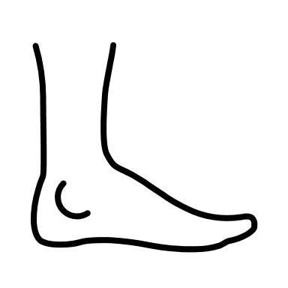
Capacitive Sensor: Hardware
Two plates
Capacitor’s dimensions
Relative movement
High thickness
Deformation of the insole
One plate
Less cables
More comfortable
Cheaper
Low thickness
VS

Slide 5
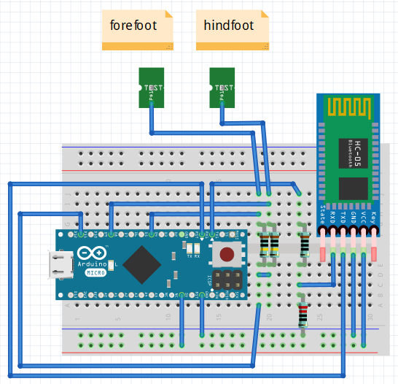
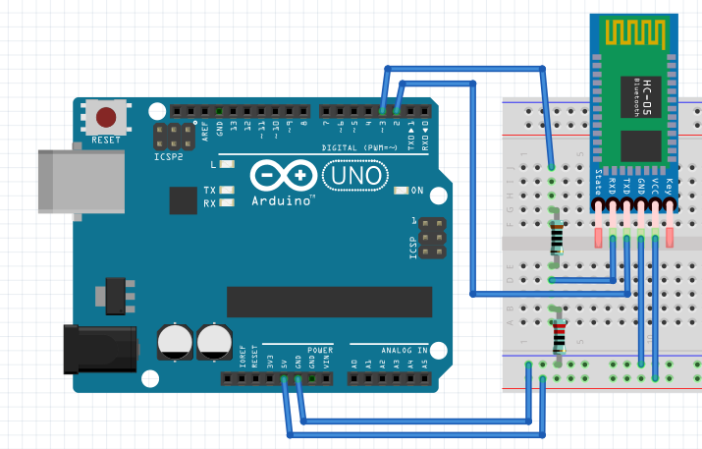
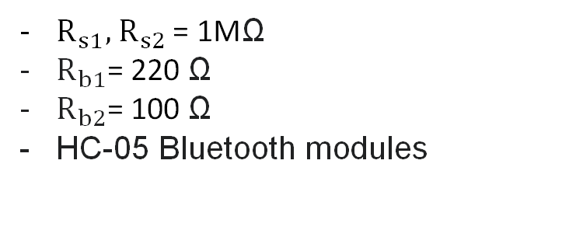
Capacitive Sensor: Hardware
$R_{s1}, { R}_{s2}$ = 1MΩ
$R_{b1}$= 220 Ω
$R_{b2}$= 100 Ω
HC-05 Bluetooth modules
Transmitter
Receiver

Slide 6
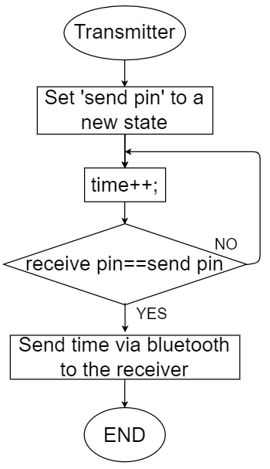
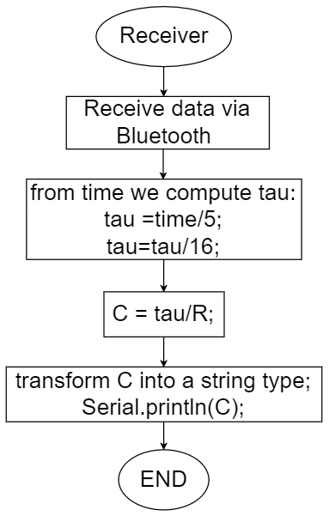

Capacitive Sensor: Flow-chart
*
*16 represents the microcontroller frequency (16Mhz)

Slide 7

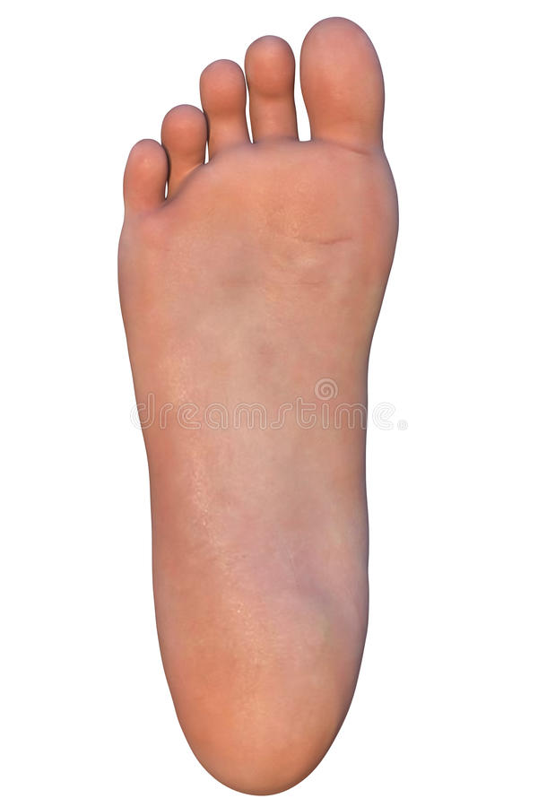
Capacitive Sensor: Software
STATIC MODE
load distribution when the patient stands up still.
DYNAMIC MODE
load distribution during time when patient walks.
Graphical Interface made with PROCESSING:
Representation of load distribution through a change of the color intensity.

Slide 8

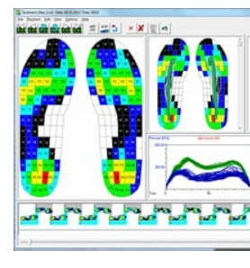
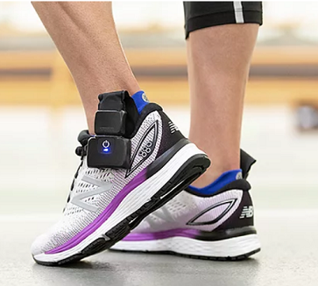
Future developments
Development of two insoles for COP analysis
Increase the insulation from the environment
Increase number of sensors on both insoles
Pedar software
Xsensor

Slide 9

Firma convenzione Politecnico di Milano e Veneranda Fabbrica del Duomo di Milano
Thank you for your kind attention!
marco7.banfi@mail.polimi.it
carlo.carraro@mail.polimi.it
pietro.chierico@mail.polimi.it
flavia.discala@mail.polimi.it
silvia.manfroni@mail.polimi.it
Aula Magna – Rettorato
Mercoledì 27 maggio 2015

